Slide 1
OPERATORS

Slide 2
ARITHMETIC OPERATORS
Assume variable a=10 and variable b=21, then –
a + b = 31
a – b = -11
a * b = 210
b / a = 2.1 (Returns a float value)
b % a = 1 (Returns the remainder after division)
a**b = 10²¹ (Performs the exponential operation and returns the value)
9//2 = 4 (Returns an integer quotient after division)

Slide 3
COMPARISON OPERATORS
These operators compare the values on either side of them and decide the relation among them. They are also called Relational operators.
Assume variable a=10 and variable b=20, then -
(a == b) is False
(a != b) is True
(a > b) False
(a < b) is True
(a >= b) is False
(a <= b) is True

Slide 4
ASSIGNMENT OPERATORS
They are also called Augmented Assignment operators. Assume variable a holds 10 and variable b holds 20, then -
c = a + b
c += a is equivalent to c = c + a
c -= a is equivalent to c = c - a
c *= a is equivalent to c = c * a
c /= a is equivalent to c = c / a
c %= a is equivalent to c = c % a
c **= a is equivalent to c = c ** a
c //= a is equivalent to c = c // a

Slide 5
LOGICAL OPERATORS
a=True and variable b=False, then -
(a and b) is False (If both the operands are True then condition becomes True)
(a or b) is True (If any of the two operands are non-zero then condition becomes True)
(not b) is True (Used to reverse the logical state of its operand)

Slide 6
MEMBERSHIP OPERATORS
Membership operators in Python test for membership in a sequence, such as strings, lists, or tuples.
Assume variable x = [2, 3, 4], then -
2 in x True
(Evaluates to True, if it finds the value in the specified sequence and False otherwise)
3 not in x False
(Evaluates to True, if it does not find the value in the specified sequence and False otherwise)

Slide 7
IDENTITY OPERATORS
These operators compare the values of two variables.
Assume variable a=10 and variable b=20, then –
a is b False
(Evaluates to True if the variables on either side of the operator have the same value, False otherwise)
a is not b True
(Evaluates to False if the variables on either side of the operator have the same value, True otherwise)

Slide 8
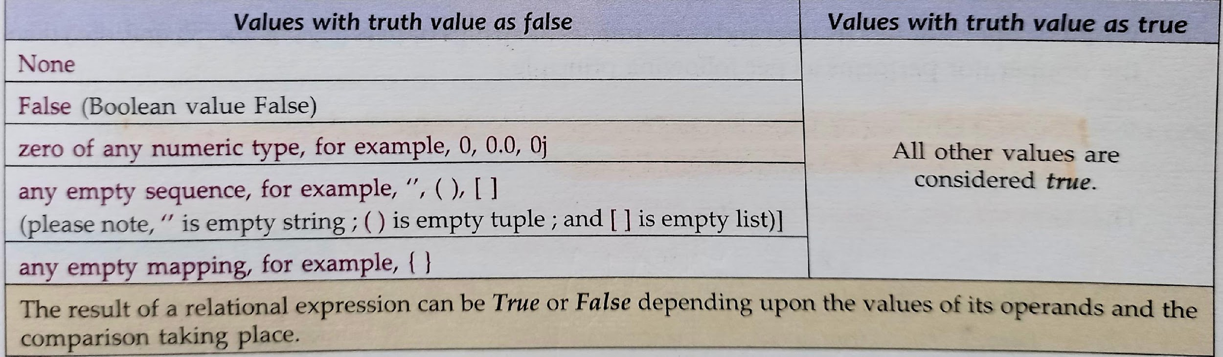
TRUTH VALUE IN PYTHON

Slide 9
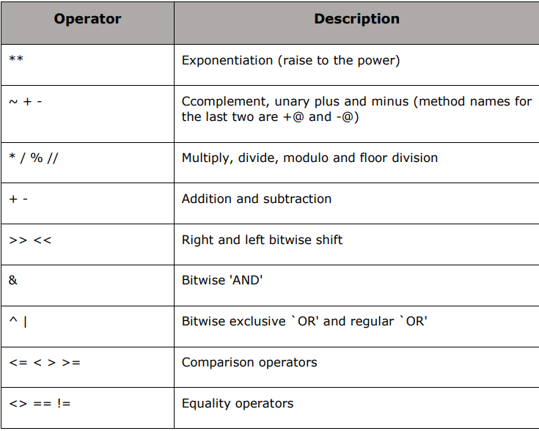
PYTHON OPERATOR PRECEDENCE
The following table lists all the operators from highest precedence to the lowest:

Slide 10
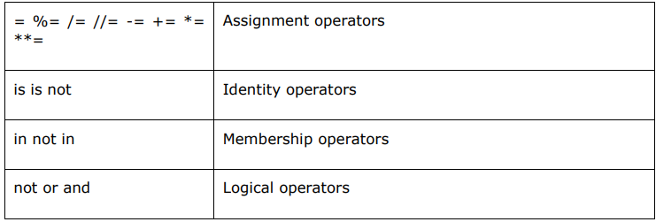
PYTHON OPERATOR PRECEDENCE (Contd.)

Slide 11
type() FUNCTION
If we are not sure, what is the data type of a value, Python interpreter can tell us:
Example 1
>>> a = 12.34
>>> type(a)
<class ‘float'>
Example 2
>>> b = 25
>>> type(b)
<class 'int'>

Slide 12
TYPE CASTING IN PYTHON
In Python, it is possible to change one type of value/variable to another type. It is known as type conversion or type casting.
The conversion can be done explicitly (programmer specifies the conversions) or implicitly (Python interpreter automatically converts the data type).
For explicit type casting, we use functions:
int()
float()
str()
bool()

Slide 13
TYPE CASTING IN PYTHON
Example 1
>>> a = 12.34
>>> b = int(a)
>>> print b Output: 12
Example 2
>>> a = 25
>>> y = float(a)
>>> print y Output: 25.0

Slide 14
Happy Learning!

